Slide 1





Complete Selenium Automation Engineer Bootcamp: Go from Zero to Hero

Slide 2
Selenium Grid
Selenium Grid (Selenium 1, Selenium 2, Selenium 3)
Framework that allows you to run your tests on different machines against different browsers in parallel.
Available in both Selenium 1 and Selenium 2.
Bundled up in Selenium stand alone server in Selenium 2 whereas it needed Apache Ant in Selenium 1 to run grid scripts.
Most commonly used Automation framework to run multiple tests in short duration of time.
Able to run multiple tests at the same time.
Saves lot of time and resources.
1hr – 10 tests x 10VM = 100 tests

Slide 3
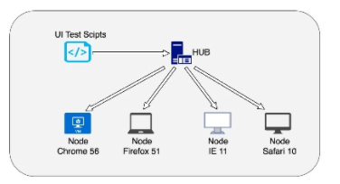
Selenium Grid Architecture

Slide 4
Selenium Grid Architecture
Selenium Grid (Selenium 1, Selenium 2, Selenium 3)
Hub:
Central point from where you can start your tests.
Can be launched only in a single machine which means only one hub is allowed in a grid.
Tests will be run on the hub, but the browser will be automated on the node.
Node:
Instances where the tests will be executed.
One can have one or multiple nodes.
Nodes can be in different machines with different platforms and browsers.
Hub can be in separate platform than the nodes executing the tests.

Slide 5
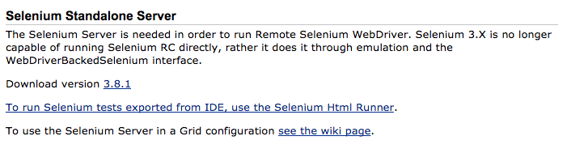
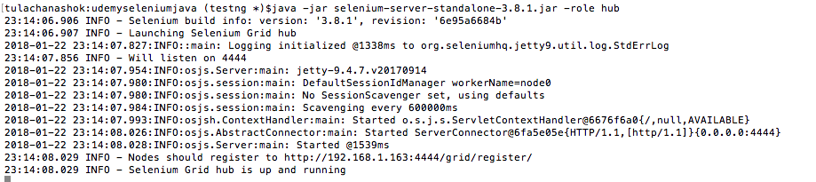
Selenium Grid : Command line
Selenium Grid Set up using Command Line.
Install selenium standalone server (3.8.1) from the link below.
http://docs.seleniumhq.org/download/
Save the server on your desired location on both hub and nodes.
Now, navigate to the folder where the selenium standalone server is installed and run the following command.
java -jar selenium-server-standalone-2.30.0.jar -role hub

Slide 6
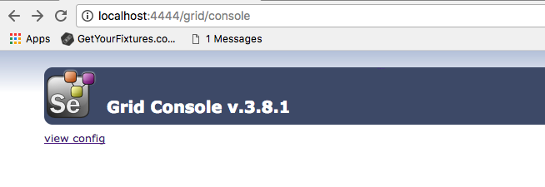
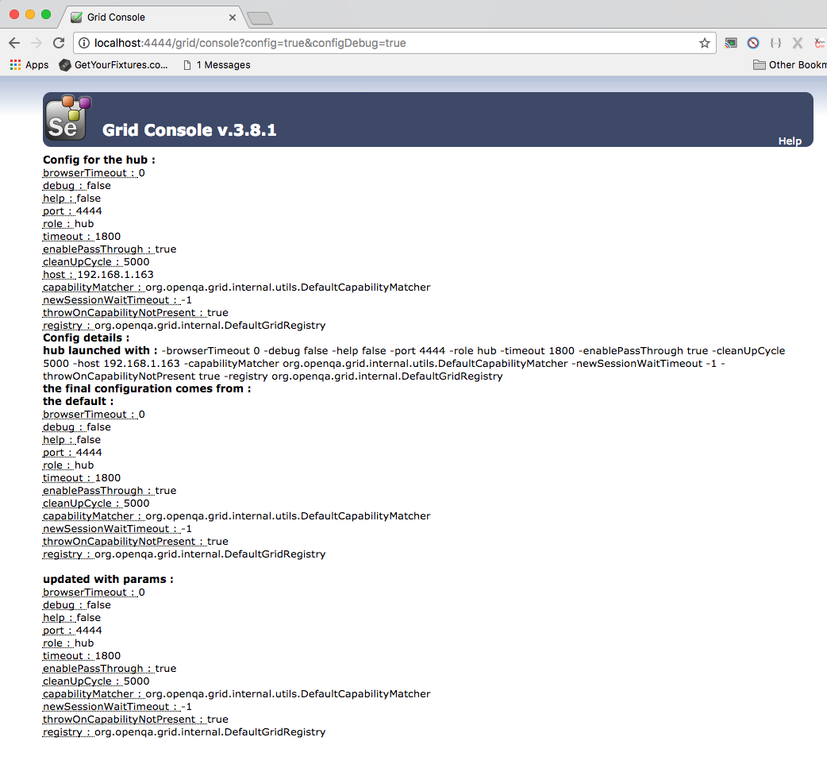
Selenium Grid : Command line
Selenium Grid Set up using Command Line.
Verify the hub is running properly by navigating to the following command.
http://localhost:4444/grid/console

Slide 7
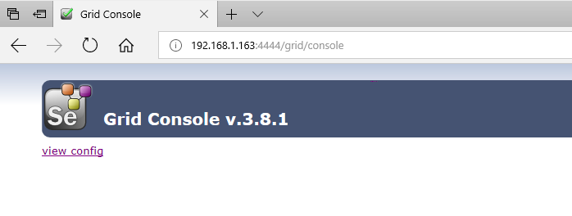
Selenium Grid : Command line
Selenium Grid Set up using Command Line.
Verify the hub can be reached from the node by running the command below.
First get the ip-address from the machine.
You can get your machine ip-address running ipconfig from windows or ifconfig on mac.
Example: 192.128.1.162
Or, you can also find out by going to this website https://www.whatismyip.com/
Then navigate to the URL below.
http://<ip-address>:4444/grid/console
You should see the page like below.

Slide 8
Selenium Grid : Command line
Selenium Grid Set up using Command Line.
Once the hub is set up, now open command prompt or terminal on the node(another machine)>
Install selenium standalone server in the node just like you did in the hub with this link below.
http://docs.seleniumhq.org/download/
Install Gecko driver if you have not already installed and put both the server and driver in your desired folder.
https://github.com/mozilla/geckodriver/releases
Now navigate to the selenium standalone server folder.
Then run the following command with the hub ip-address and any port you would like to run.
java -Dwebdriver.gecko.driver="/Users/tulachanashok/Documents/Udemy-Selenium-Java/udemyseleniumjava/geckodriver.exe" -jar selenium-server-standalone-3.8.1.jar -role webdriver -hub http://<hub ip-address>:4444/grid/register -port 5566

Slide 9
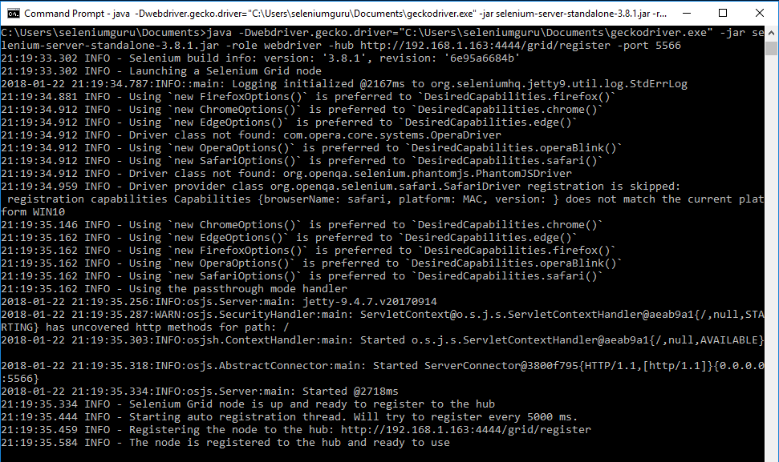
Selenium Grid : Command line
Selenium Grid Set up using Command Line.

Slide 10
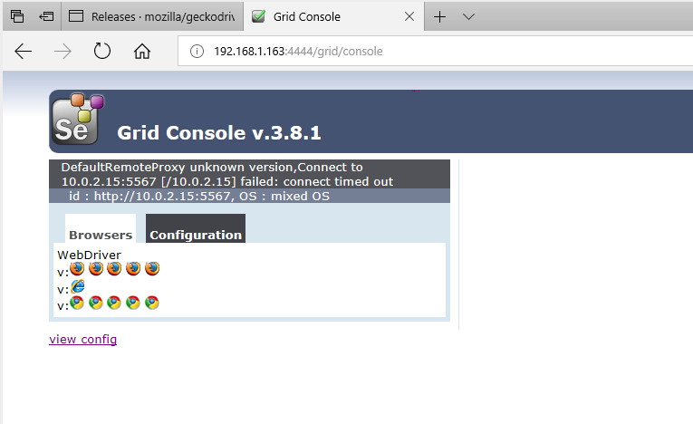
Selenium Grid : Command line
Selenium Grid Set up using Command Line.
Now verify the hub is connected with grid and selenium grid is set up properly by navigating to the URL below.
http://<hub ip-address>:4444/grid/console

Slide 11
Selenium Grid : Command line
Selenium Grid Set up using Command Line.
Verify the node is running properly by navigating to the following command.
http://localhost:4444/grid/console

Slide 12
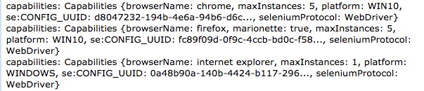
Selenium Grid : Command line
Selenium Grid Test Script Design
Selenium Grid requires modification of test scripts in order to execute the test scripts on multiple machines.
Desired Capabilities and Remote WebDriver objects needs to be implemented in order to run the selenium grid script.
DesiredCapabilities: Contains all the configuration of browser i.e. type, platform, browserName, maxInstances and type.
RemoteWebDriver: Driver required to run the selenium grid scripts by setting node or machine on which tests can be run.

Slide 13
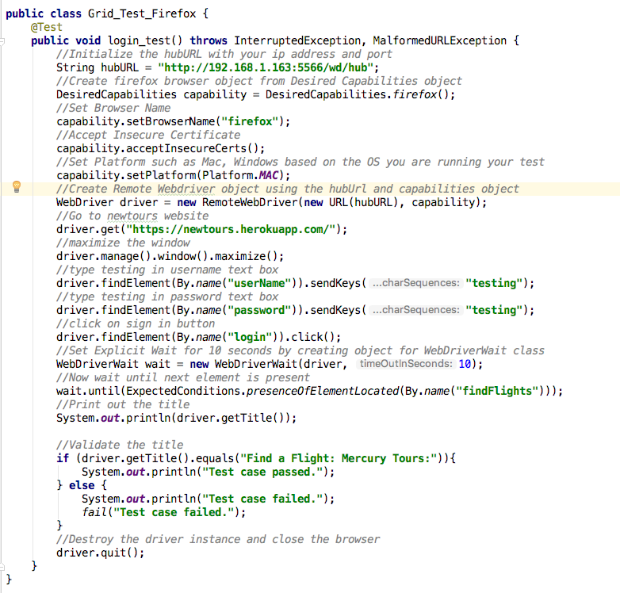
Selenium Grid : Command line
Selenium Grid Test Script Design: Firefox

Slide 14
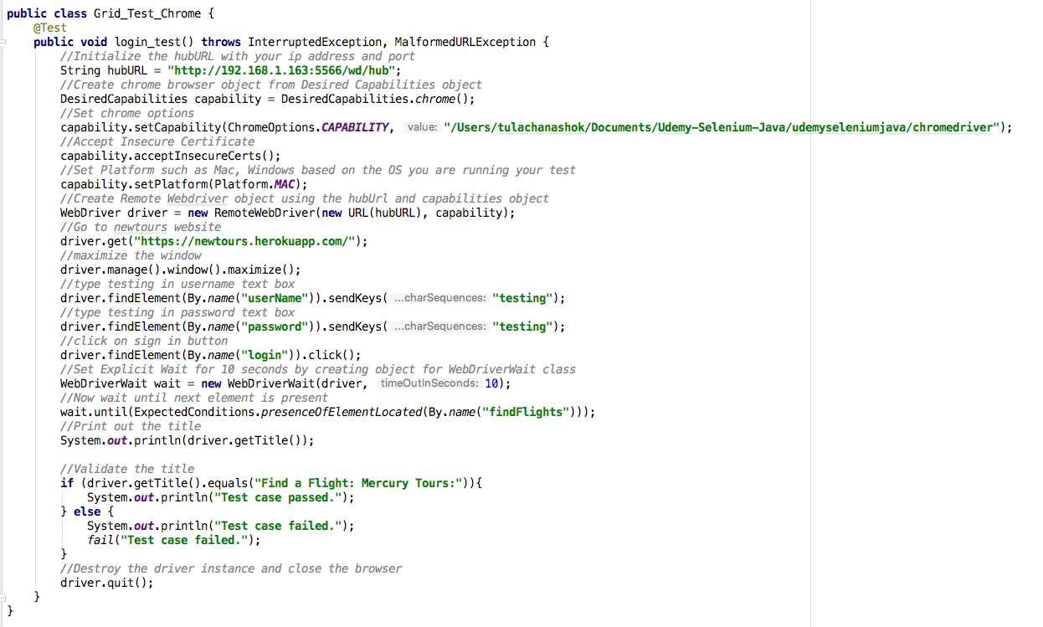
Selenium Grid : Command line
Selenium Grid Test Script Design: Chrome

Slide 15
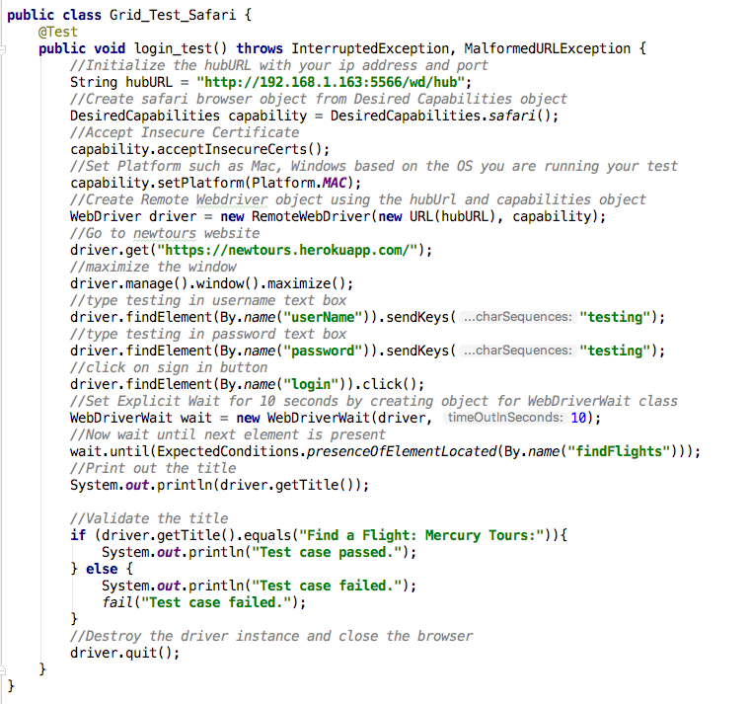
Selenium Grid : Command line
Selenium Grid Test Script Design: Safari

Slide 16
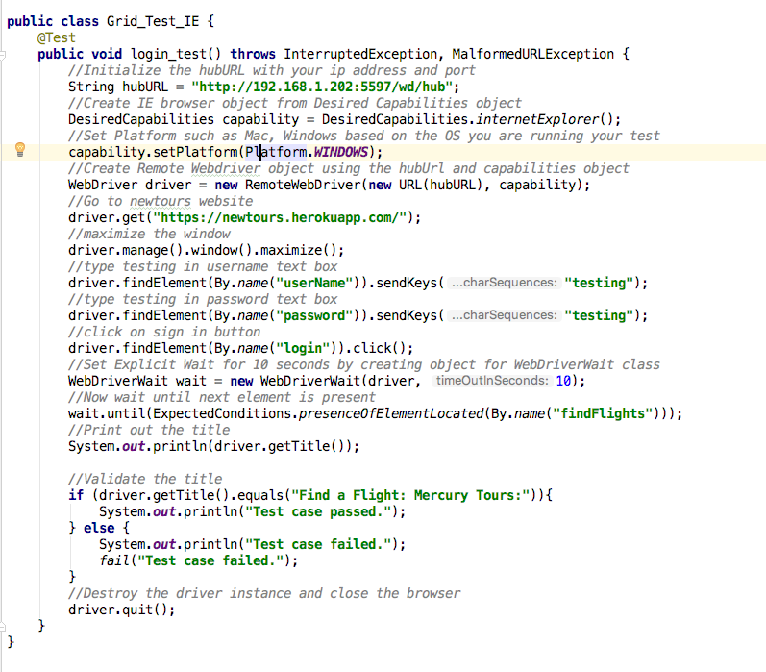
Selenium Grid : Command line
Selenium Grid Test Script Design: IE

Slide 17
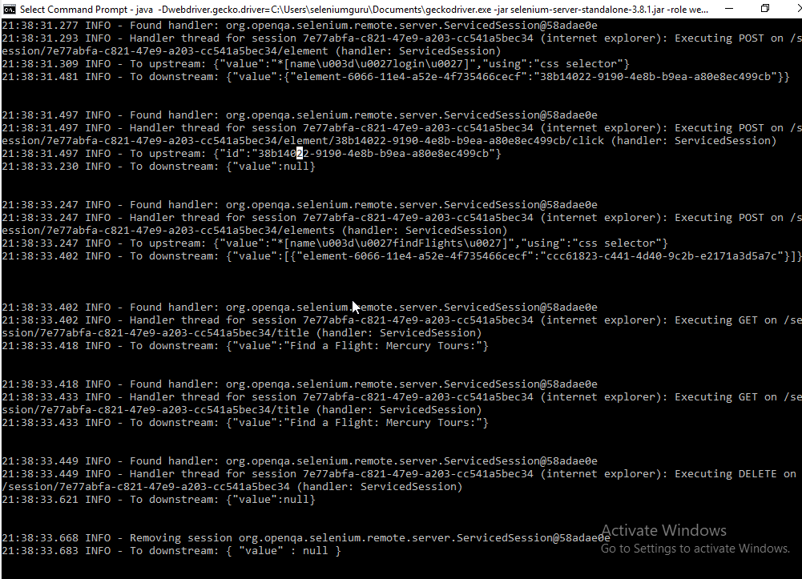
Selenium Grid : Command line
Selenium Grid Test Script Design: IE

Slide 18
Selenium Grid : Command line
Selenium Grid Test Script Design: Parallel Execution
First set up the hub with the command line.
java -jar selenium-server-standalone-3.8.1.jar -role hub
Second set up the first node.
java -Dwebdriver.gecko.driver=/Users/tulachanashok/Documents/Udemy-Selenm- Java/udemyseleniumjava/geckodriver - Dwebdriver.chrome.driver=/Users/tulachanashok/Documents/Udemy-Selenium- Java/udemyseleniumjava/chromedriver.exe -jar selenium-server-standalone-3.8.1.jar -role webdriver -hub http://localhost:4444/grid/register -port 5555

Slide 19
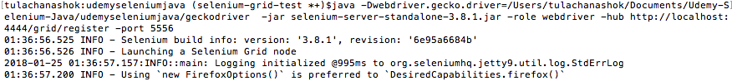
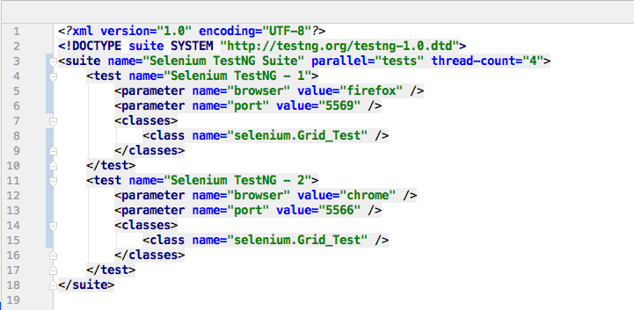
Selenium Grid : Command line
Selenium Grid Test Script Design: Parallel Execution
Third, Set up the node by running the command below.
Now, configure your testng file as shown below.

Slide 20
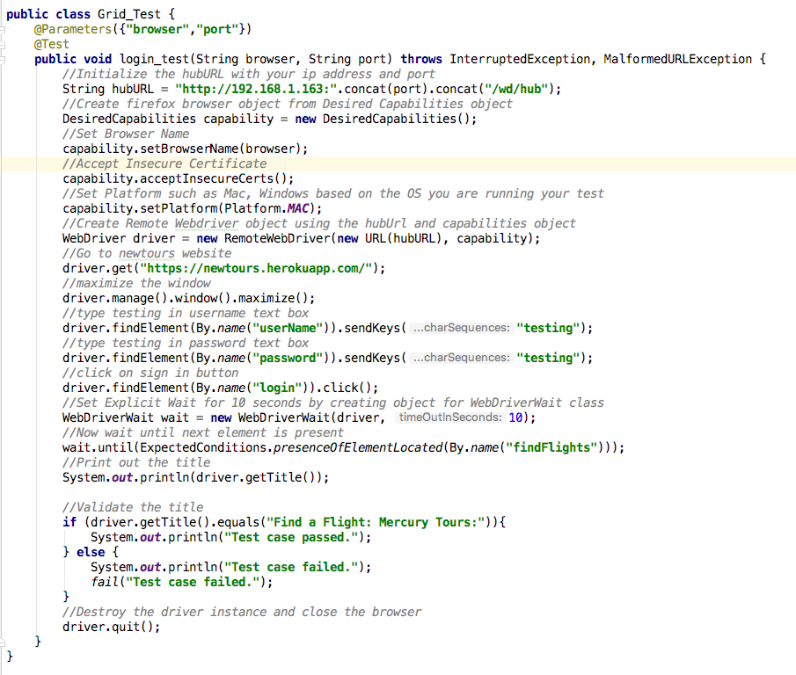
Selenium Grid : Command line
Selenium Grid Test Script Design: Parallel Execution
Then configure your Grid_Test as shown below.

Slide 21
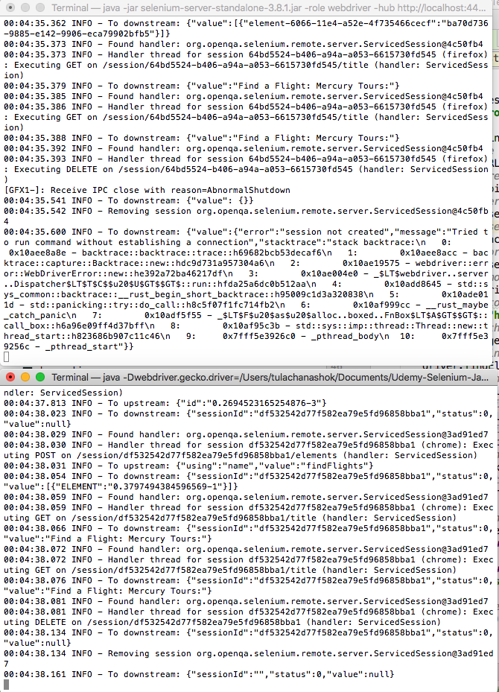
Selenium Grid : Command line
Selenium Grid Test Script Design: Parallel Execution

Slide 22
Selenium Grid : JSON
Selenium Grid Test Script Design: JSON
JSON – JSON stands for Javascript Object Notation.
Similar to XML file but commonly used for interchange of data between browser and the web server.
Hub and Node browser configuration can also be saved and used to run the selenium grid scripts.
JSON config file can be downloaded from here.
https://github.com/SeleniumHQ/selenium/blob/master/java/server/src/org/openqa/grid/common/defaults/DefaultHub.json
Save the file in your project folder as hubConfig.json
Then set up selenium hub by running the command below.
java -jar selenium-server-standalone-3.8.1.jar -role hub -hubConfig hubConfig.json

Slide 23
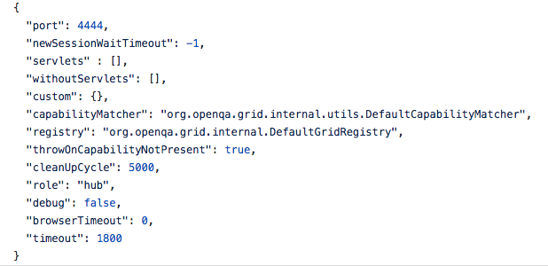
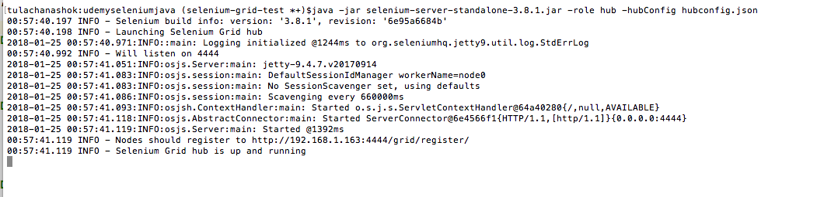
Selenium Grid : JSON
Selenium Grid Test Script Design: Hub Configuration

Slide 24
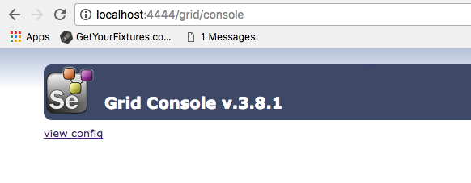
Selenium Grid : JSON
Verify the hub is configured successfully by navigating to theURL
http://localhost:4444/grid/console

Slide 25
Selenium Grid : JSON
Selenium Grid Test Script Design: Node Configuration.
Node JSON config file can be downloaded from here.
https://github.com/SeleniumHQ/selenium/blob/master/java/server/src/org/openqa/grid/common/defaults/DefaultNodeWebDriver.json
Save the file in your project folder as node1.json
Copy the same json content and save it in another file as node2.json
You can set up as many nodes as you would like copying the file above and naming it as node1.json, node2.json and so on.
Then set up selenium node by running the command below.
java -D-Dwebdriver.gecko.driver="geckodriver.exe" -jar selenium-seer-standalone-3.8.1.jar -role node -nodeConfig node1.json
java -D-Dwebdriver.gecko.driver="chromedriver.exe" -jar selenium-server-standalone-3.8.1.jar -role node -nodeConfig node2.json

Slide 26
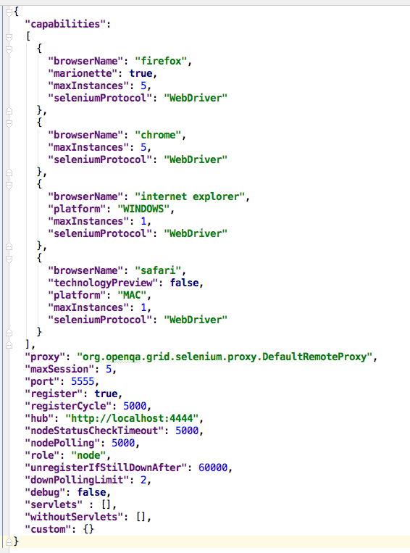
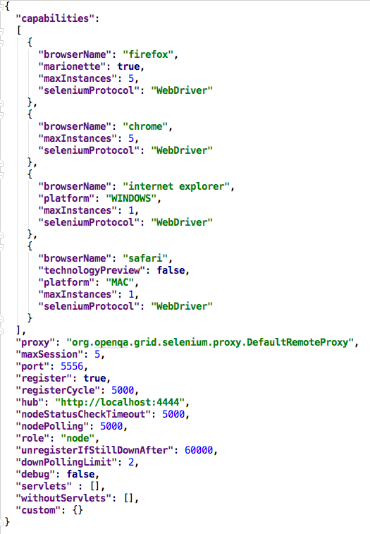
Selenium Grid : JSON
Node 1 & 2 Configuration

Slide 27
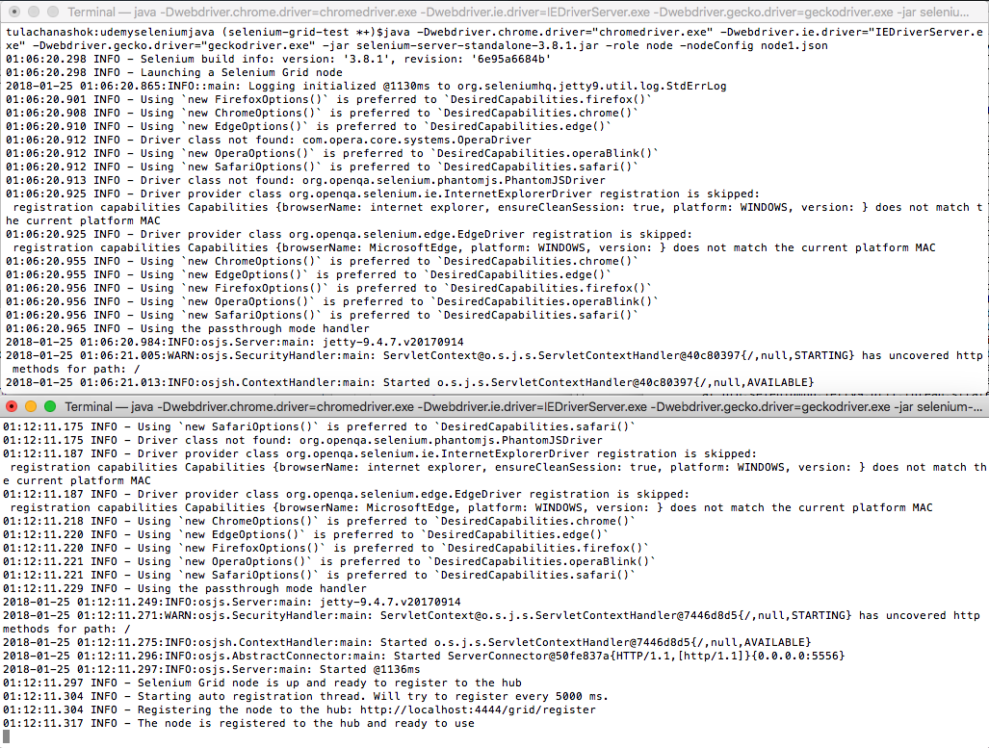
Selenium Grid : JSON
Verify the node1 and node2 is registered to hub successfully as below.

Slide 28
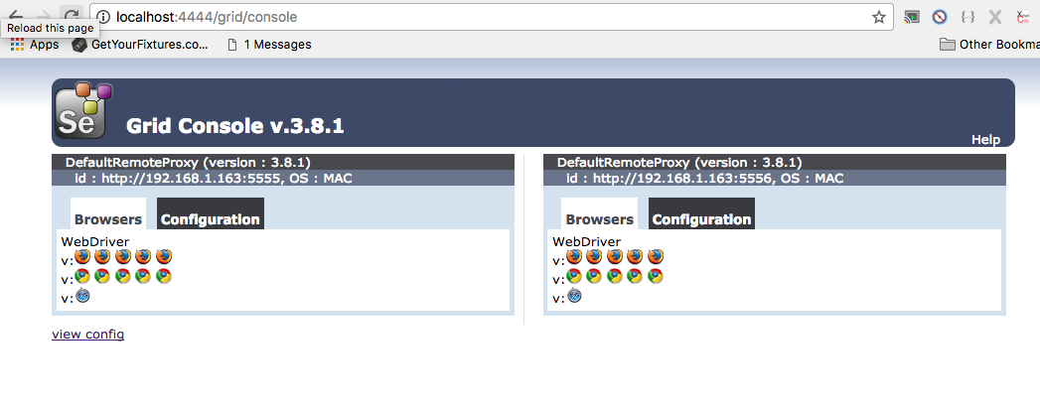
Selenium Grid : JSON
Selenium Grid Console

Slide 29
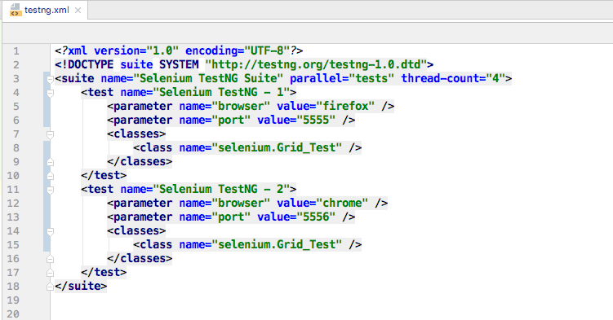
Selenium Grid : JSON
Selenium Grid Parallel Execution with JSON
Configure testng file as shown below.

Slide 30
Selenium Grid : JSON
Selenium Grid Test Script Design: Parallel Execution
Then configure your Grid_Test as shown below.

Slide 31
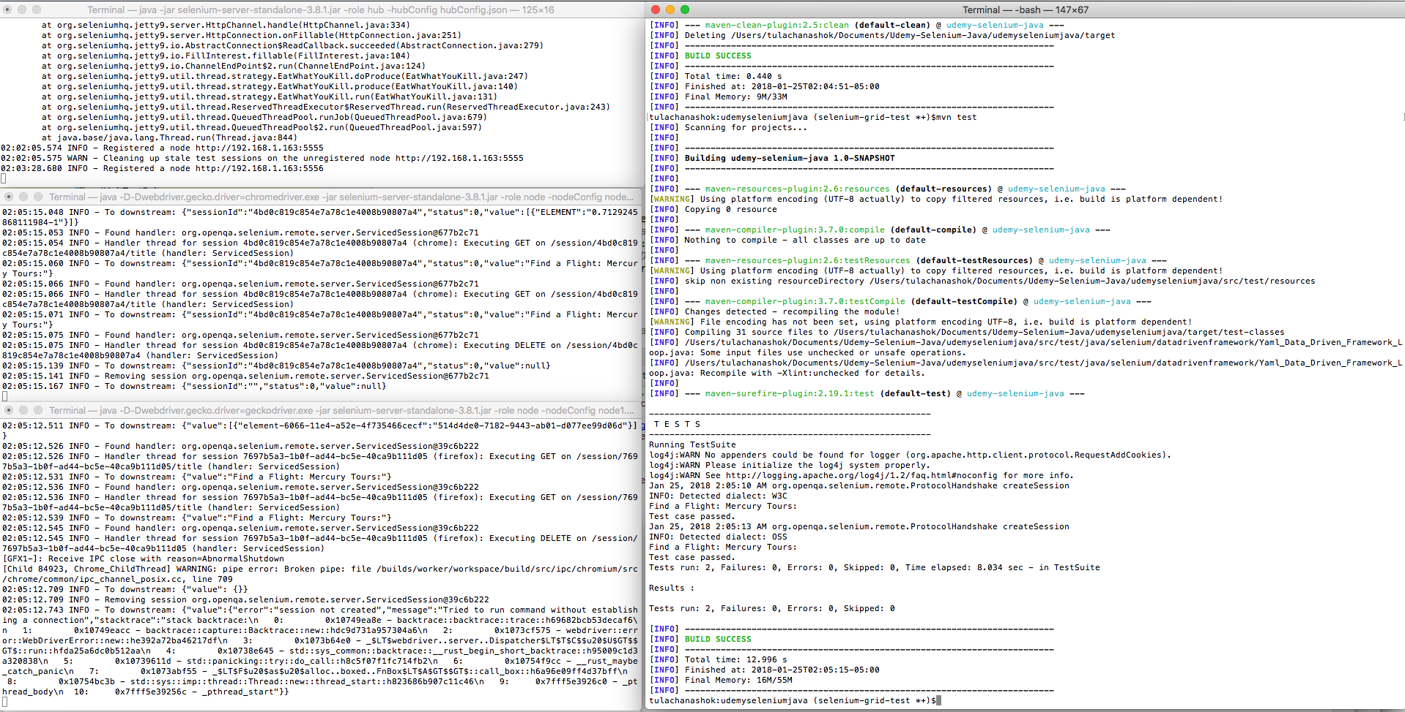
Selenium Grid : JSON
Selenium Grid Parallel Execution with JSON
Now execute your test using maven command as shown below.
mvn clean test
Test execution should look as below with parallel tests running.

